Slide 1
THE KC HOUSE PROJECT

Slide 2
The Goal
To build understand the factors that can predict the impact of home renovations on the estimated value of houses.
To help the real estate agency provide homeowners with actionable recommendations on which renovations are most likely to yield a higher return on investment

Slide 3
Factors that affect the buying of a house
Location i.e lat, long
Price of the house
Number of bedrooms
Number of bathrooms
Square footage of the living space
Square footage of the lot
Total floors in the house
Whether the house is on a waterfront
Grading level around the house
Square footage of the house apart from the basement
Square footage of the basement area
Year when the house was built
Year when the house was renovated
Zip code of the house
Special view
Conditional of the house

Slide 4
DATA HANDLING METHODS USED :
Data cleaning
Handling outliers
Handling duplicated
Explanatory analysis
Data analyis
Data modelling /predictive analysis
Data visualization

Slide 5
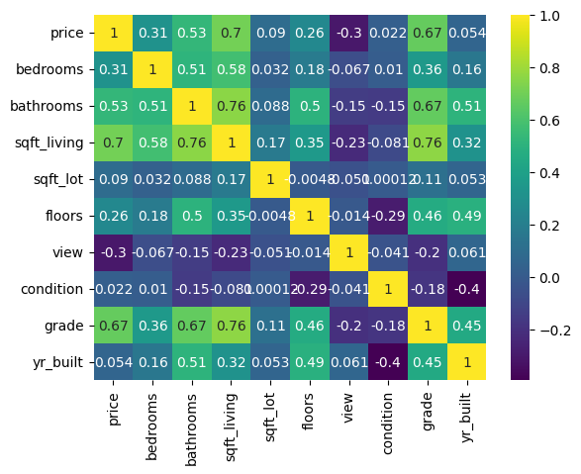
To check the correlation between the variables

Slide 6
There is a close relationship between the price of a house and the grade where the fact on whether a house is a graded as a mansion,luxury,excellent, better it will affect the price of the house.

Slide 7
